Slide 1



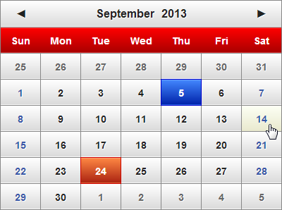

jQuery Overview
Unleash the Power of jQuery
SoftUni Team
Technical Trainers
Software University
http://softuni.bg

Slide 2


Table of Contents
What is jQuery?
jQuery Fundamentals
Selectors
DOM Manipulation
DOM Altering
jQuery DOM Elements
jQuery Events
AJAX
jQuery AJAX Methods
Executing AJAX Requests

Slide 3
What is jQuery?
The World’s Most Popular JavaScript Library

Slide 4

What is jQuery?
jQuery is a cross-browser JavaScript library
Designed to simplify the client-side scripting of DOM
The most popular JavaScript library in use today
Free, open-source software by jQuery Foundation
jQuery's syntax is designed to make it easier to
Navigate through the document and select DOM elements
Create animations / transitions / effects
Handle DOM events

Slide 5
What is jQuery? (2)
jQuery has very large community
Used in 540,000 sites (Nov 2014)
Microsoft adopted jQuery within Visual Studio ad ASP.NET MVC
jQuery provides capabilities for developers to create plugins for
Low-level interaction and animations
Advanced effects and high-level, theme-able widgets
Creation of powerful and dynamic web pages
Official web site: http://jquery.com

Slide 6
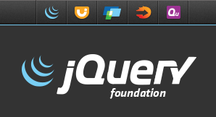
Why jQuery is So Popular?
Easy to learn
Easy to extend
Create new jQuery plugins by writing JavaScript functions
Powerful DOM Selection
Powered by CSS 3.0
Lightweight
Community Support
Large community of developers and geeks

Slide 7
How to Add jQuery to a Web Site?
Download the jQuery scripts from:
http://www.jquery.com
Self hosted
You can choose to self host the .js file
E.g. jquery-2.1.1.js or .min.js file
Use it from CDN (content delivery network)
Microsoft, jQuery, Google CDNs
e.g. http://code.jquery.com/jquery-2.1.1.min.js

Slide 8

Including jQuery in a Project
Live Demo

Slide 9
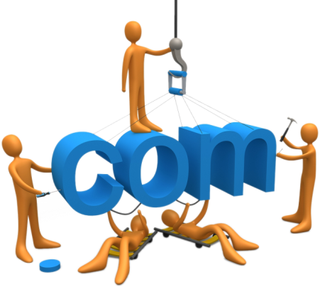

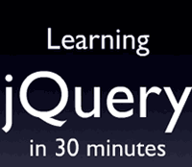

Selectors and DOM Manipulation

Slide 10
Selection with jQuery
jQuery selectors returns a collection of the items
Even if there is only one item
Can be stored in a variable or used right away
http://learn.jquery.com/using-jquery-core/selecting-elements/
$('div') // Like: document.getElementsByTagName('div');
$('.menu-item') // Like: document.getElementsByClassName('.menu-item');
$('#navigation') // Like: document.getElementById('navigation');
$('ul.menu li') // Like: document.querySelectorAll('ul.menu li');
$('div').css('background', 'blue'); // Make all DIVs blue

Slide 11
jQuery Selectors
DOM elements selection in jQuery is much like as in JavaScript
All selector
Class selector
Element selector
Id selector
Multiple selector
$('*') // Selects all elements
$('.class') // Selects all elements by class name
$('section') // Selects all elements by tag name
$('#id') // Selects a element by given id attribute
$('selector1, selector2') // Combines two selectors

Slide 12
Filter Selectors
$('li:even') // Even <li>
$('li:odd') // Odd <li>
$('li:first') // First <li>
$('li:last') // Last <li>
$('li:first-child') // Selets the first child of <li>
$('li:has(p)') // Selects all <li> holding <p> inside
$('li:contains("Sofia")') // Selects <li> holding given text
$('li:eq(2)') // Selects the element at index 2
$('li:not(:checked)') // Elements not matching the selector

Slide 13
Attribute Selectors
Attribute selectors support "contains" / "starts with" semantic
<body>
<a href="index.html" hreflang="en">Home</a>
<a href="about.html" hreflang="en-UK">About</a>
<a href="contacts.html" hreflang="bg">Contacts</a>
</body>
contains
<script>
$('a[hreflang*="en"]').css('color', 'red');
$('a[hreflang^="en"]').css('color', 'green');
</script>
starts with

Slide 14
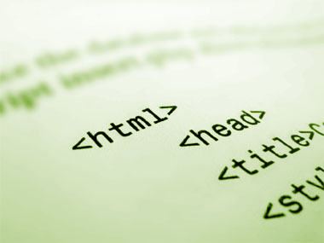
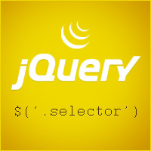
Selection with jQuery
Live Demo

Slide 15
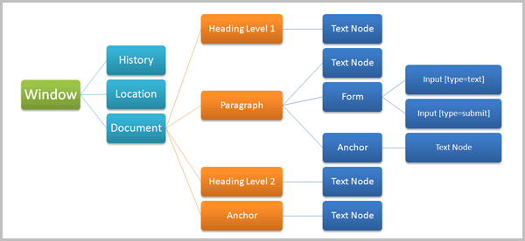
DOM Traversal
Traversing the Nodes of the DOM

Slide 16
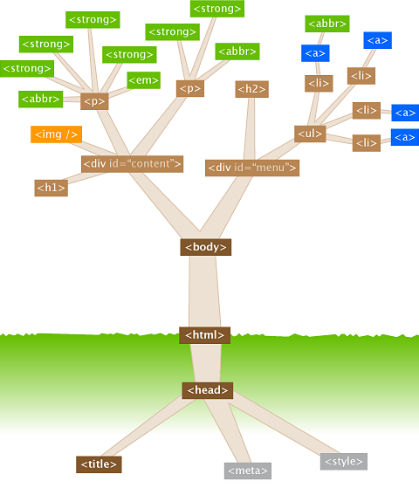
DOM Traversal
The DOM can be traversed with jQuery, as with plain JavaScript
jQuery has properties for:
Next and previous siblings
Parents and children
First and last in a collection
It is impossible to reference elements that are not yet rendered at the time of script execution!

Slide 17
DOM Traversal: Next and Previous
jQuery.next(), jQuery.prev()
Returns the next / previous sibling
Returns an HTML element, not a [text] node
next([selector]) & prev([selector]) can take selector
Returns the next/previous sibling, that matches selector
<ul>
<li>Item 1</li>
<li>Item 2</li>
<li>Item 3</li>
</ul>
var first = $('li').first();
console.log(first.text()); // "Item 1"
console.log(first.next().text()); // "Item 2"
console.log(first.prev().text()); // ""

Slide 18
DOM Traversal: Parent
jQuery.parent()
Returns the parent of the element
jQuery.parents([selector])
Returns the first parent that matches the selector
<div id="wrapper">
<ul id="items-list">
<li>Item 1</li>
<li>Item 2</li>
<li class="special">Item 3</li>
<li>Item 4</li>
</ul>
</div>
var node = $('.special');
node.parent().attr('id'); // "items-list"
node.parents('div').attr('id'); // "wrapper"
node.parents('#wrapper').attr('id'); // "wrapper"

Slide 19
DOM Traversal: Children
jQuery.children()
Returns the children of the element
jQuery.children([selector])
Returns the children of element, filtered by a selector
<div id="wrapper">
<ul id="items-list">
<li>Item 1</li>
<li>Item 2</li>
<li class="special">Item 3</li>
<li>Item 4</li>
</ul>
</div>
var list = $('#items-list');
var items = list.children(); // gets all list items
var specials = list.children('.special');
//gets all list items with class special

Slide 20

DOM Traversal
Live Demo

Slide 21
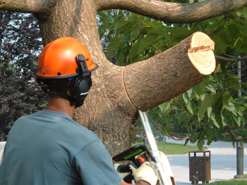

Altering the DOM with jQuery
Adding and Removing DOM Elements

Slide 22

Adding Elements
Adding elements can be done on the fly
jQuery.appendTo() / jQuery.prependTo()
jQuery.append() / jQuery.prepend()
<h2>SoftUni Greetings</h2>
<div id="wrapper">
<div>Hello, student</div>
<div>Goodbye, student</div>
</div>
<h2>SoftUni Greetings</h2>
<div id="wrapper">
<div>Hello, student<p>Test</p></div>
<div>Goodbye, student<p>Test</p></div>
</div>
<div>First</div>
<h2>SoftUni Greetings</h2>
<div id="wrapper">
<div>Hello, studentdiv>
<div>Goodbye, student<div>
</div>
$('#wrapper div').append('<p>Test</p>');
$('<div>First</div>').prependTo('body');

Slide 23
Creating Elements
Creating new elements is also easy
with the jQuery HTML parser
with document.createElement
A little bit faster
var divElement = $('<div>');
var anotherDiv = $('<div />');
var paragraph = $('<p>Some text</p>');
var divElement = $(document.createElement('div'));

Slide 24
Removing Elements
You can also remove elements from the DOM
Just as easy
<div>
<p>Red</p>
<p>Green</p>
</div>
<script>
$('p').remove(); // Remove all paragraphs
</script>
<!–- Result: -->
<div>
</div>

Slide 25
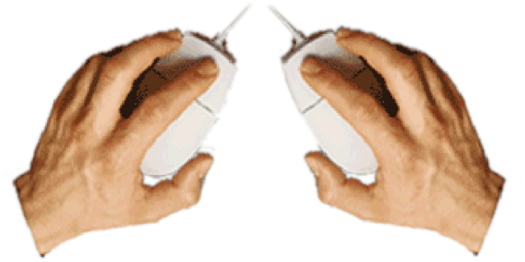

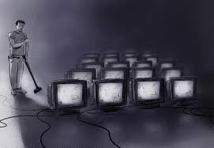
Altering the DOM with jQuery
Live Demo

Slide 26

jQuery Extended DOM Elements

Slide 27
jQuery Objects
Selected elements with jQuery are not pure DOM elements
jQuery elements extend regular DOM elements
They have additional properties and methods
addClass(), removeClass(), toogleClass()
on(event, callback) for attaching events
animate(), fade(), etc…
// Parsing a regular DOM element to jQuery element
var content = document.createElement('div'); // DOM element
var $content = $(content); // jQuery extended DOM element

Slide 28
Properties of jQuery Elements
Methods for altering the elements
jQuery.css('color', '#f3f')
jQuery.html() – returns the innerHTML
jQuery.html(content) – sets the innerHTML
jQuery.text(content) – gets / sets the innerHTML as text
Performs HTML escaping of the passed content
jQuery.val(content) – sets the value of input field

Slide 29
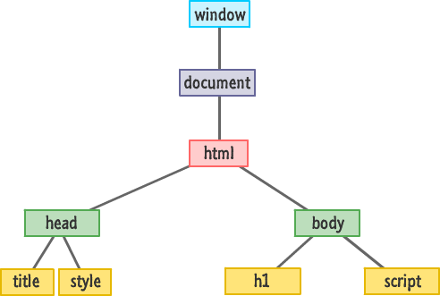
Changing the Elements Content
Live Demo

Slide 30

jQuery Events
Cross-Browser Events Handling

Slide 31
jQuery Events
jQuery has a convenient way for attaching and detaching events
Works cross-browser
Using methods on() and off()
function onButtonClick() {
$('.selected').removeClass('selected');
$(this).addClass('selected');
// "this" is the event source (the hyperlink clicked)
}
$('a.button').on('click', onButtonClick);

Slide 32
jQuery Events (2)
Handling events on multiple elements
Add a handler on the parent element
A bit different syntax
function onListItemClick(){
$('.selected').removeClass('selected');
$(this).addClass('selected');
}
$('ul').on('click', 'li', onListItemClick);

Slide 33

jQuery Event Handlers
Live Demo

Slide 34
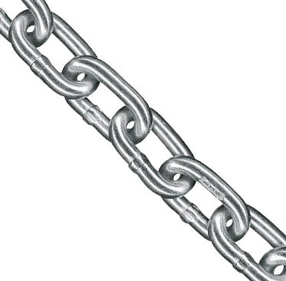
Chaining Function Calls
Call After Call, After Call, …

Slide 35
jQuery: Chaining Function Calls
In programming , the "chaining" paradigm is as follows:
If a method should return result -> OK, return it
If a method should NOT return a result -> return this
jQuery implements the "chaining" paradigm, so methods can be chained one after another:
$('<button />').remove()
.addClass('btn-success')
.html('Click me for success')
.on('click', onSuccessButtonClick)
.appendTo(document.body);

Slide 36
jQuery Function Calls Chaining
Live Demo

Slide 37
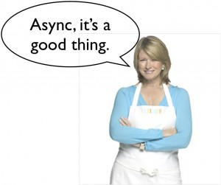
jQuery AJAX
Creating HTTP Requests with jQuery

Slide 38
jQuery AJAX
AJAX stands for Asynchronous JavaScript and XML
Asynchronously load data from a service and render it dynamically
jQuery provides several methods for AJAX
jQuery.ajax([options]) – performs HTTP request with full control (headers, data, method, etc…)
jQuery.get([url]) – performs HTTP GET request
jQuery.post([url]) – performs HTTP POST request
jQuery([selector]).load([url]) – loads the contents from the url inside the selected node

Slide 39
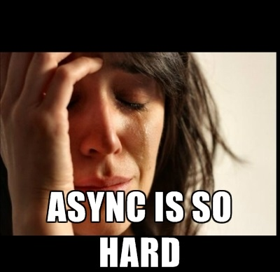
jQuery AJAX
Live Demo

Slide 40


Summary
jQuery – the most popular client-side JS library
Select DOM elements with jQuery
$([selector])
DOM Traversal:
$([selector]).next() / parent()
Altering the DOM:
$([selector]).html(…) / append(…)
jQuery Events
$([selector]).on([event], [callback]);
JS Apps

Slide 41







JavaScript Applications
https://softuni.bg/courses/javascript-applications/

Slide 42
License
This course (slides, examples, demos, videos, homework, etc.) is licensed under the "Creative Commons Attribution-NonCommercial-ShareAlike 4.0 International" license
Attribution: this work may contain portions from
"JavaScript Applications" course by Telerik Academy under CC-BY-NC-SA license

Slide 43





Free Trainings @ Software University
Software University Foundation – softuni.org
Software University – High-Quality Education, Profession and Job for Software Developers
softuni.bg
Software University @ Facebook
facebook.com/SoftwareUniversity
Software University @ YouTube
youtube.com/SoftwareUniversity
Software University Forums – forum.softuni.bg

